Slide 1
Electric cookstove adoption in Kenya Tanzania Susanna Berkouwer (Penn Wharton) Joshua Dean (Chicago Booth) Timeline: Pilot in July-August 2024 (N=200) Launch in Q1 2025 (N=2000)

Slide 2
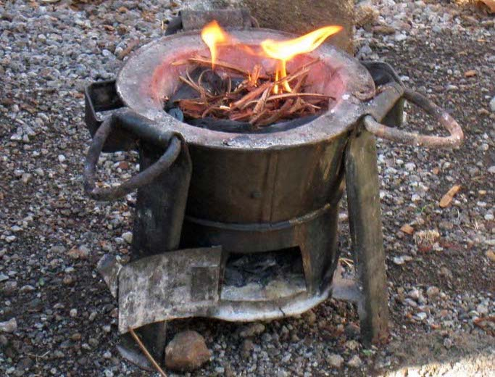
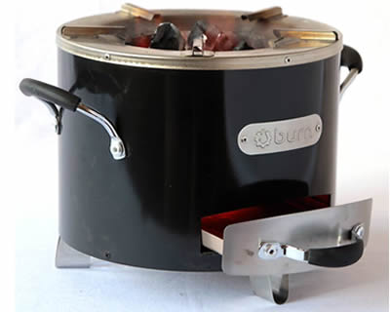
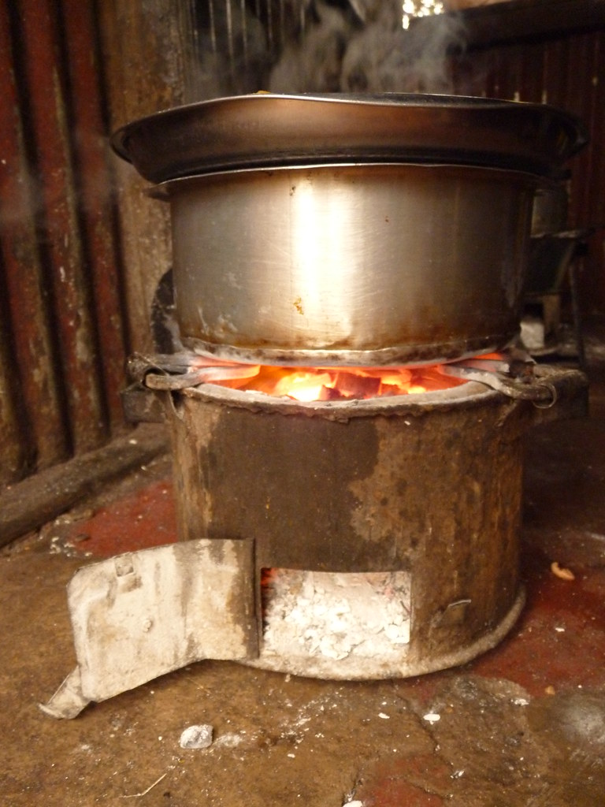
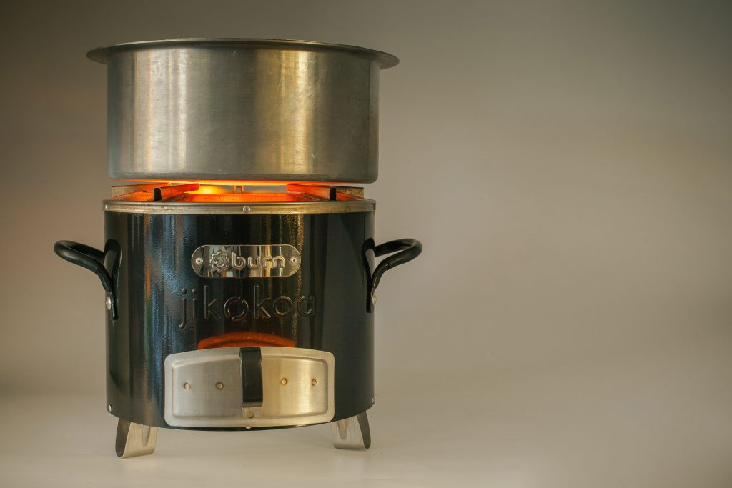

Slide 3

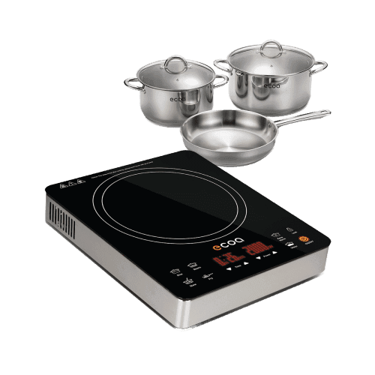

Slide 4
Possible benefits
Save money
Save time
Healthier
Reduce CO2 (Kenya’s grid is 50% geothermal, 40% hydro)

Slide 5
Why might people not want to adopt an electric cookstove?

Slide 6
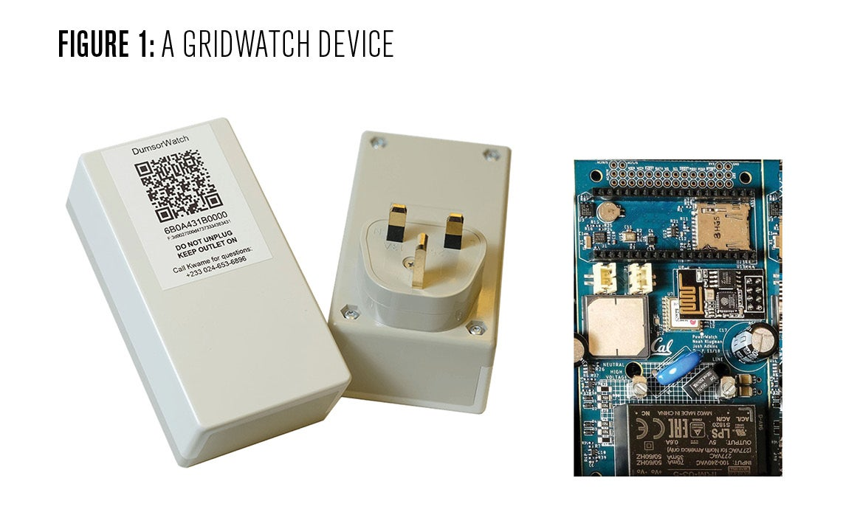
Why might people not want to adopt an electric cookstove?

Slide 7
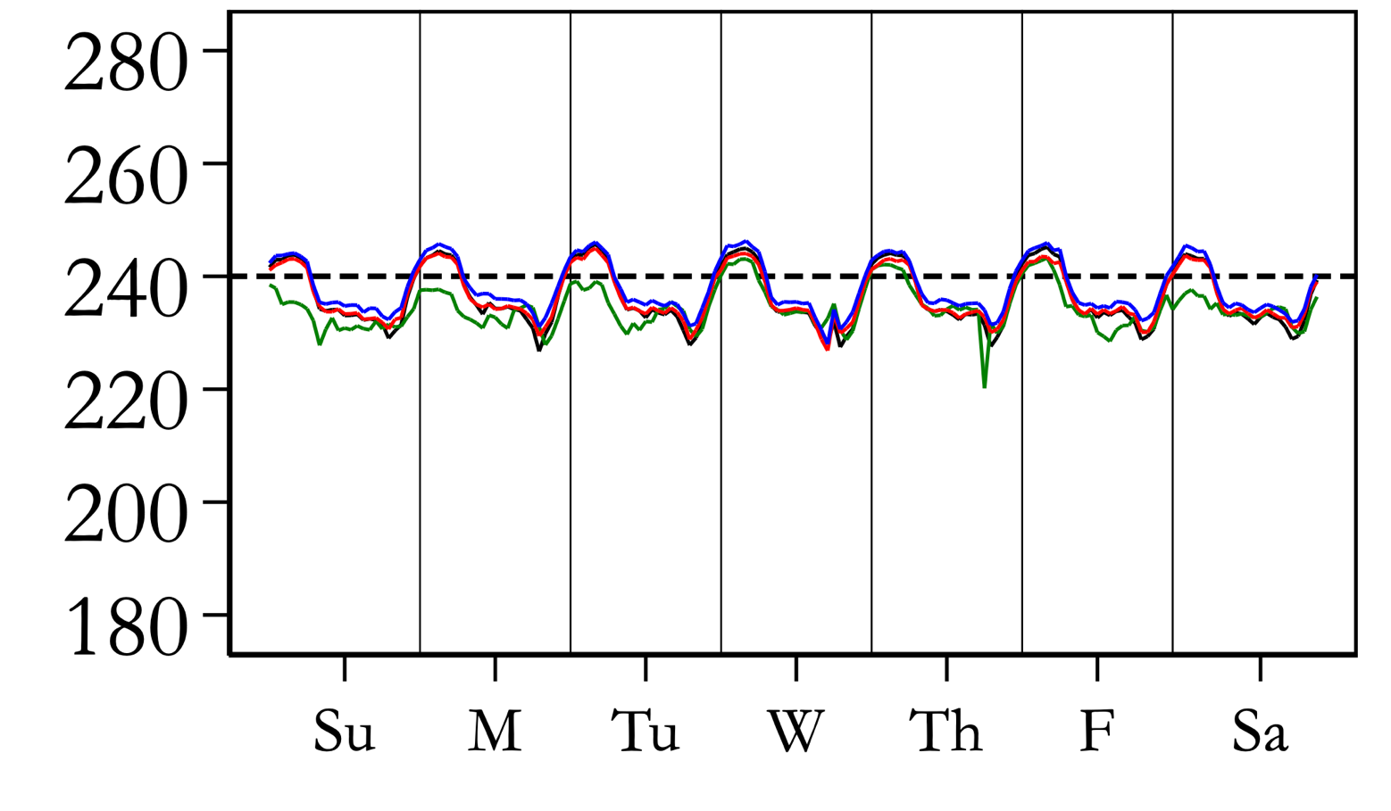
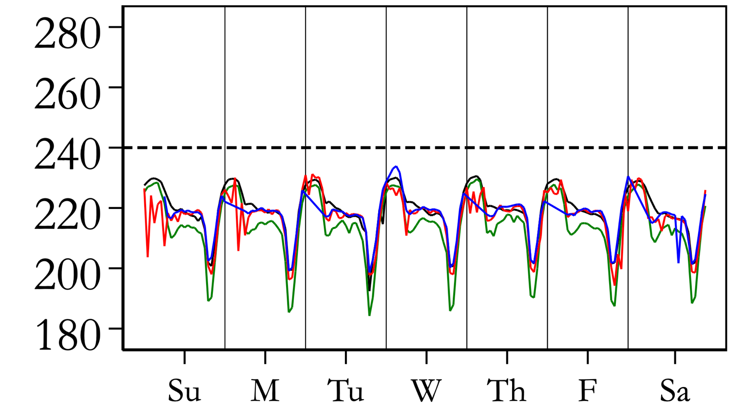
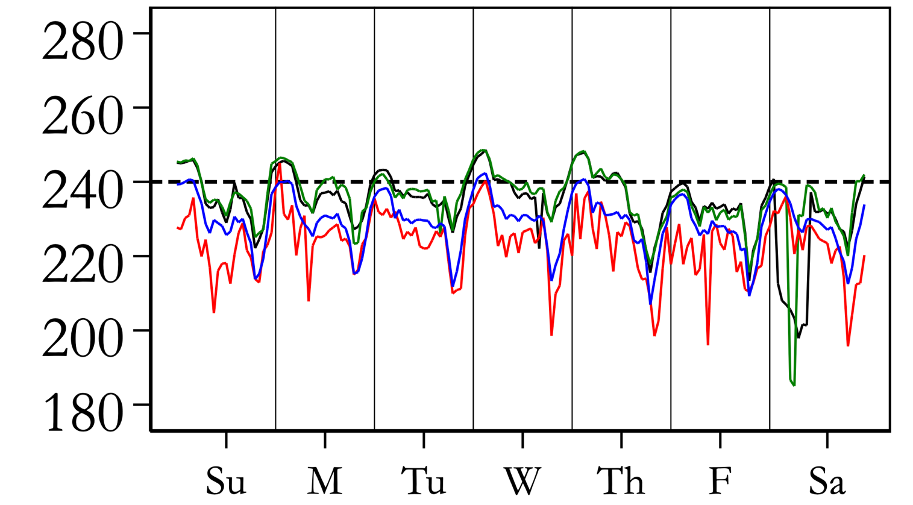
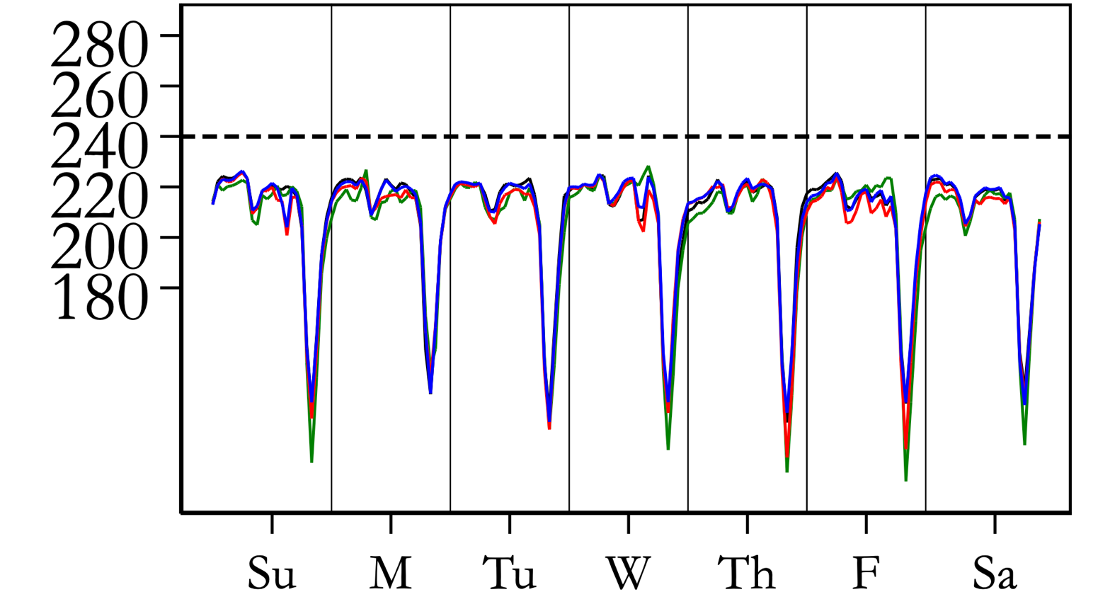
Why might people not want to adopt an electric cookstove?
Tieng’re Transformer, Seme Constituency, Kisumu
Mwirosti Transformer
Constituency, Kakamega County
Esibeye Transformer, Luanda Constituency, Vihiga
Mukavakava Transformer, Malava Constituency, Kakamega

Slide 9
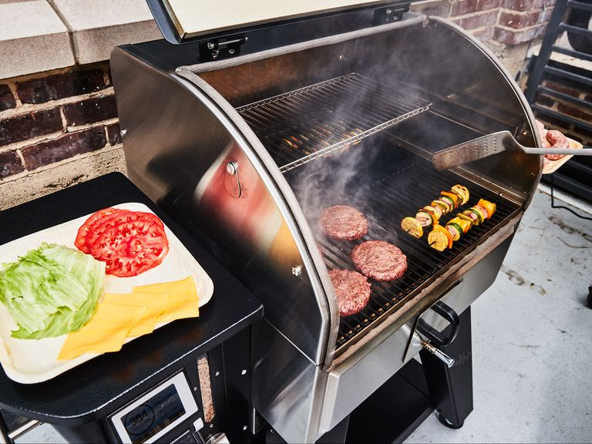
Why might people not want to adopt an electric cookstove?

Slide 10
Policy goal: reduce usage of a fossil fuel appliance
Two policy levers:
1. Subsidize upfront cost of electric appliance
-> adoption margin
2. Subsidize electricity prices
-> adoption margin and usage margin
Research question:
What is the cost in $/tCO2 for each policy lever?

Slide 11
Data we’ll collect:
WTP
Electricity expenditures (pre-paid top ups)
Other energy expenditures (wood, charcoal, LPG)
Power quality (GridWatch, self-reported)
Time use
Self-reported health

Slide 12
Planned RCT
Randomize price
Randomize electricity prices
Randomize whether electricity prices are shown before or after adoption decision

Slide 13


Pilot

Slide 14


Pilot

Slide 15
Policy goal: reduce usage of a fossil fuel appliance
Two policy levers:
Subsidize upfront cost of electric appliance
Subsidize electricity prices
Research question: what is the $/tCO2 for each subsidy?
Key objects to estimate:
Demand curve
Electricity usage elasticity to electricity cost
WTP elasticity to electricity cost
Discount rate
Myopia

